Slide 1
Sound and video editing
Lesson 6: Visual effects

Slide 2
Objectives
In this lesson, you will learn how to:
use visual effects to enhance a video advert
apply transitions between video clips.

Slide 3
What does the visual effect do?
Watch these four video clips before a visual effect has been applied to them and after a visual effect has been applied to them.
Write down what the visual effect does.
How does the video change when the visual effect has been applied?
Watch Video 6.1

Slide 4
Adding visual effects to your advert
You have created a video advert for Hachette Travel. Now you will apply visual effects to create a polished final product.
Here’s a reminder of the brief:
Hachette Travel organises holidays for families abroad, including flights. It would like to sell more holiday packages and it thinks a video advert will help it get more customers. It plans to show the advert online.
The advert must:
be no longer than 30 seconds
include a voiceover
include background music
include at least three audio effects
include at least five different video clips
include Hachette Travel’s logo, which should be on screen throughout
include at least three visual effects.

Slide 5
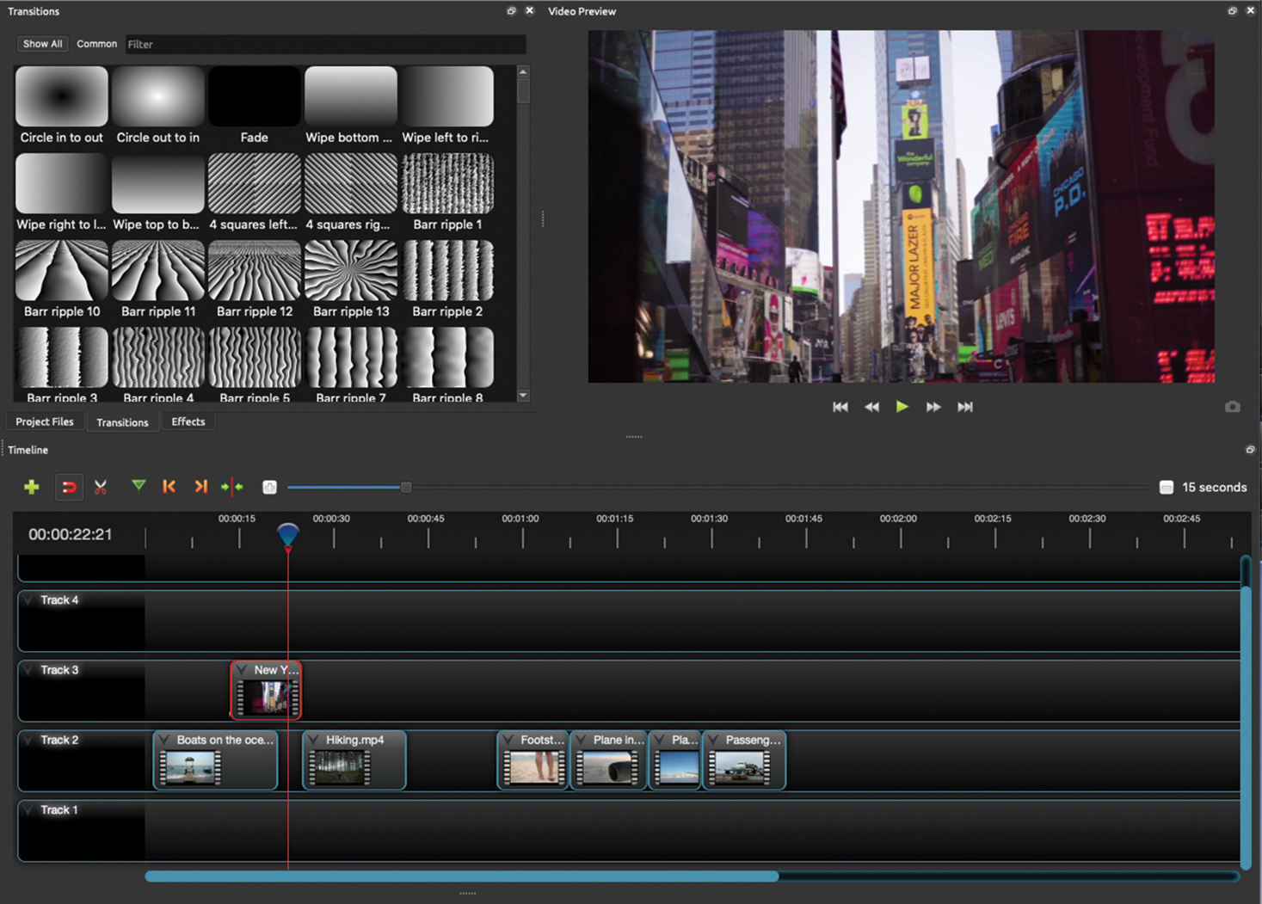
Transitions
You can apply transitions between video clips to add some excitement when the video changes from one scene to the next and smooth the passage between clips.
Click on the ‘Transitions’ tab, choose a transition, drag it to the appropriate track and trim it.
Watch Video 6.2

Slide 6

Activity 6.1: Applying transitions
Experiment with different transitions and then apply at least one transition to your video advert.
Remember to update your timeline to show the transitions added.

Slide 7
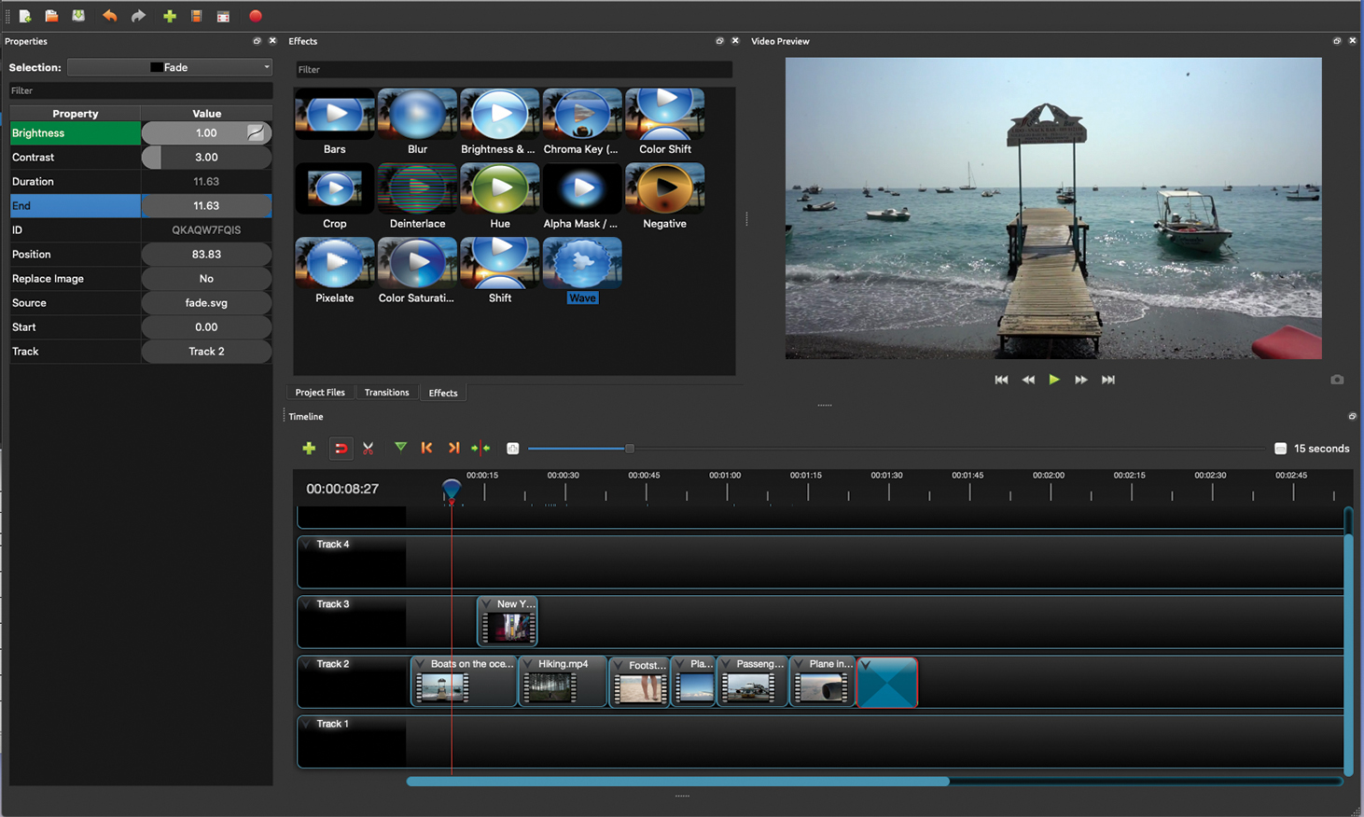
Other visual effects
You can apply other visual effects to your video advert to make it more interesting and exciting to watch.
Click on the ‘Effects’ tab, choose an effect and drag it to the appropriate track. Then click on it and adjust the values of each property of the effect.
Watch Video 6.3

Slide 8
Activity 6.2: Applying other visual effects
Experiment with different visual effects and then apply at least one to your video advert.
Remember to update your timeline to show the visual effects added.

Slide 9
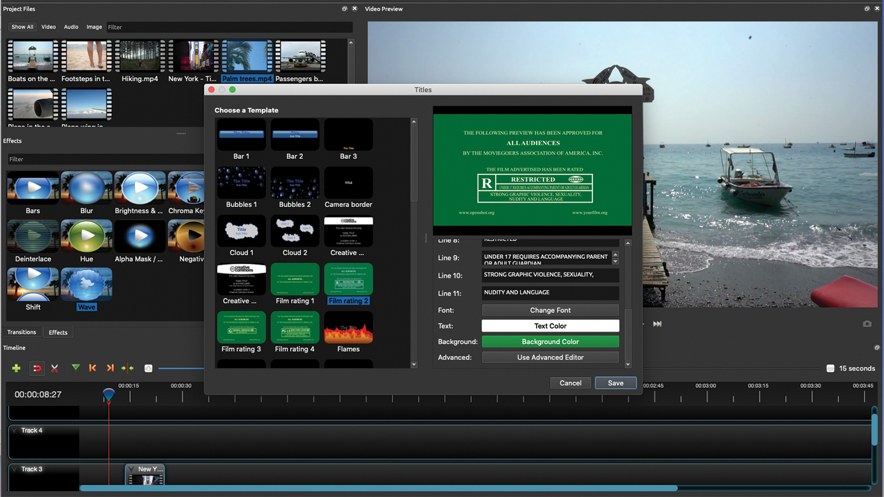
Titles
You can add titles (extra words) to your video advert to tell the viewer something important.
Click on ‘Title’ in the menu bar, then ‘Title’ and choose a template. Type in the text and adjust the font, text colour and background colour and click ‘Save’.
Finally, drag the title to a new track and trim it according to your timeline.
Watch Video 6.4

Slide 10
Activity 6.3: Adding titles
Do you want to add titles to your video advert? Perhaps you could emphasise half price travel until the end of July by displaying ‘50% off’ at the appropriate time.
Remember to update your timeline to show any titles added.

Slide 11
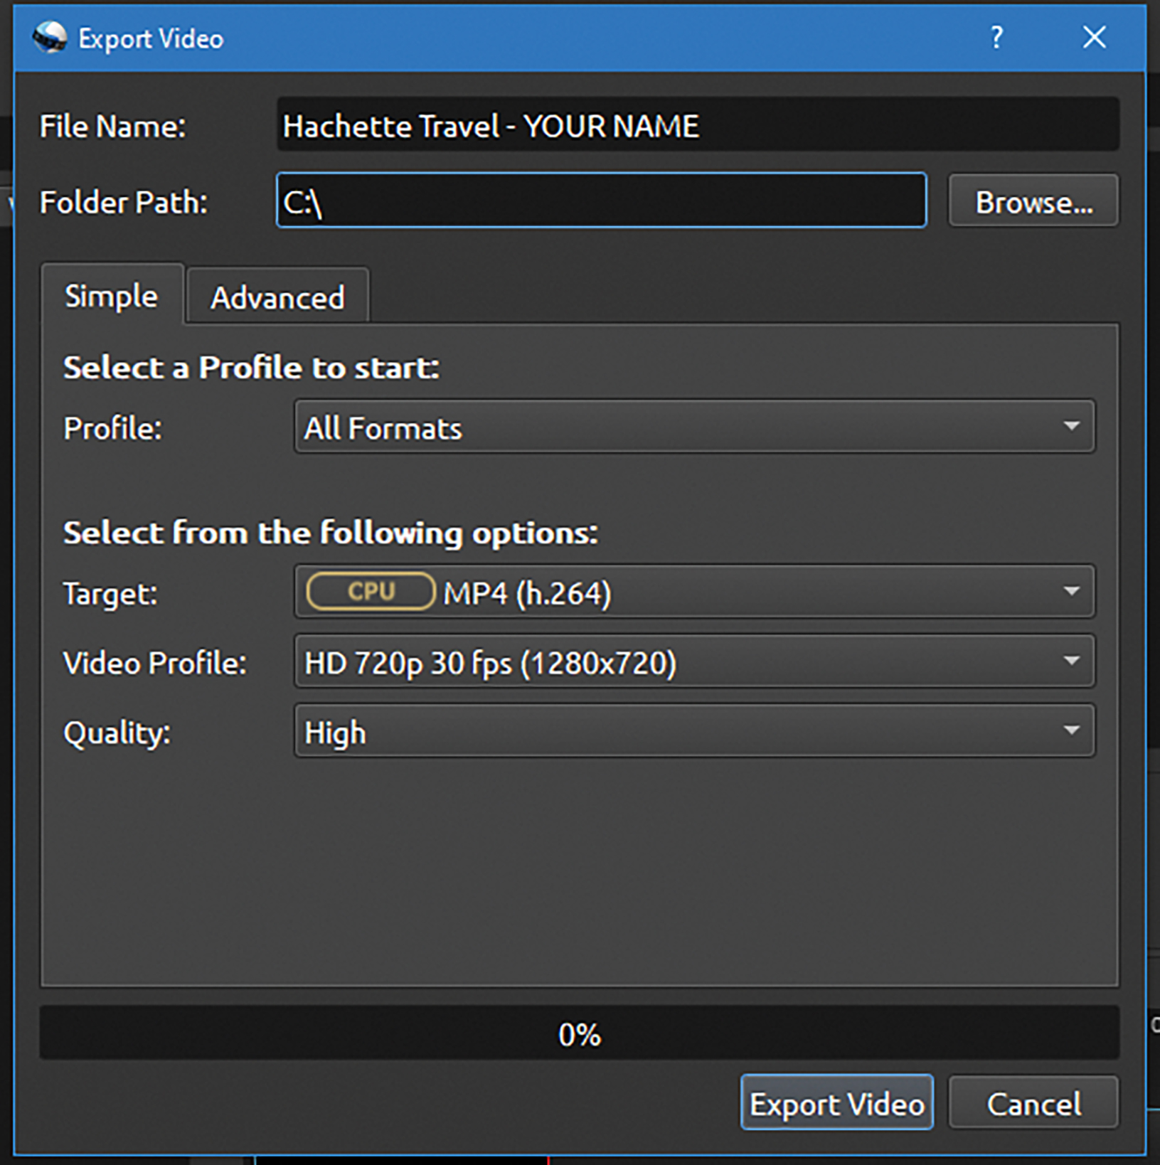
Exporting your video
When you have finished your video advert, you need to export it in a high-quality video format so you can deliver it to Hachette Travel.
Click on ‘File’ in the menu bar, ‘Export Project’ and ‘Export Video’.
Type in the file name and choose where you want the exported video to save to in the ‘Folder Path:’ box. Then make sure the following options are selected and click ‘Export Video’.
Watch Video 6.5

Slide 12
Activity 6.4: Export your video advert
Now it is time to export your video advert.

Slide 13
Activity 6.5: What do you think of this advert?
Watch the advert and discuss the following questions:
Does this advert look professional? Why/why not?
What would make the video look more professional?
Is there anything you like about this video?

Slide 14
Quiz 6

